Slide 1

Dynamic Generation of Modular Industrial Plant Visualizations
Weekly Meeting 10
Miguel Romero Karam

Slide 2
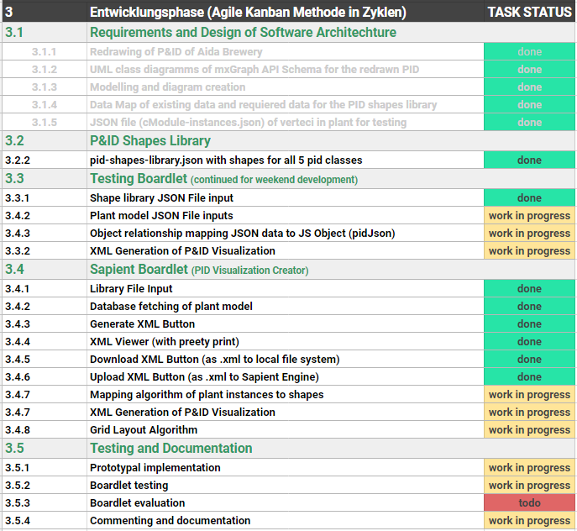
Task Backlog – Overview Overview of tasks: Week 10

Slide 3
Task Backlog – Overview Overview of tasks: Week 10

Slide 4
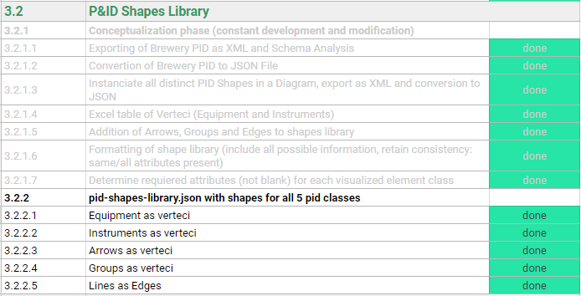
P&ID Shapes Library Weekly Sprint 10
Changes to equipment
Size modifications to be made (defaults left for now)
Arrows and groups defined in library but won’t be implemented for now
Groups are defined in l_nodes, they will serve for inclusion graphing algorithm
4 shape types defined. shapeName defines line type:
 | 1 | pipe_line
 | 2 | connection_line
 | 3 | signal_line
 | 4 | data_line

Slide 5
Task Backlog – Overview Overview of tasks: Week 10

Slide 6
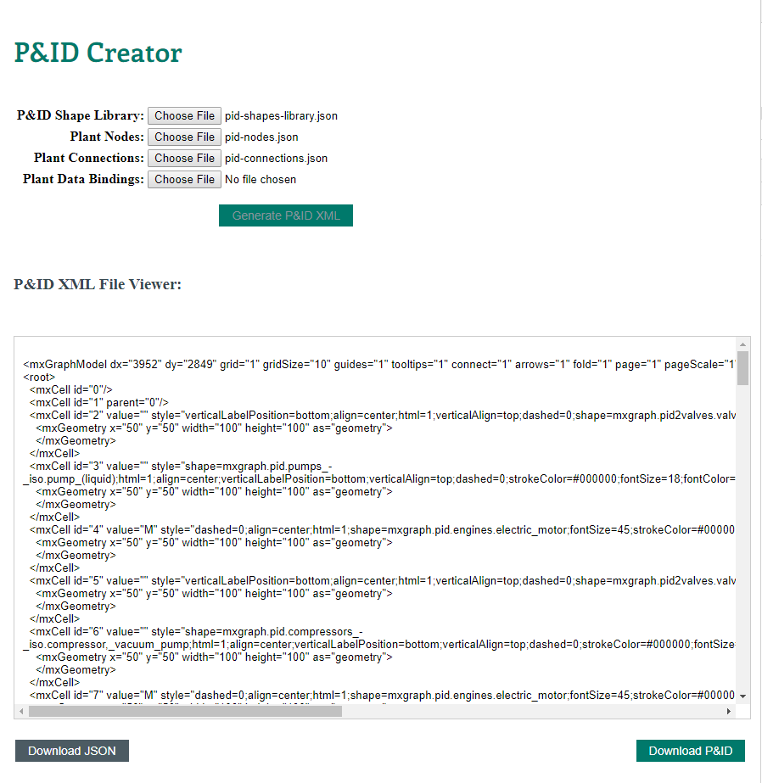
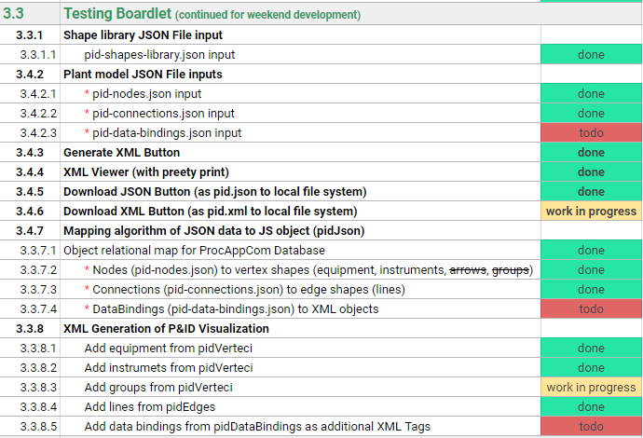
Testing Boardlet Weekly Sprint 10
In client- background
Allows work during weekend
Allows testing with json data * (instead of database fetches)
Separation of concerns. 3 DB fetches → 3 separate json file inputs for model

Slide 7


Task Backlog – Overview Overview of tasks: Week 10

Slide 8
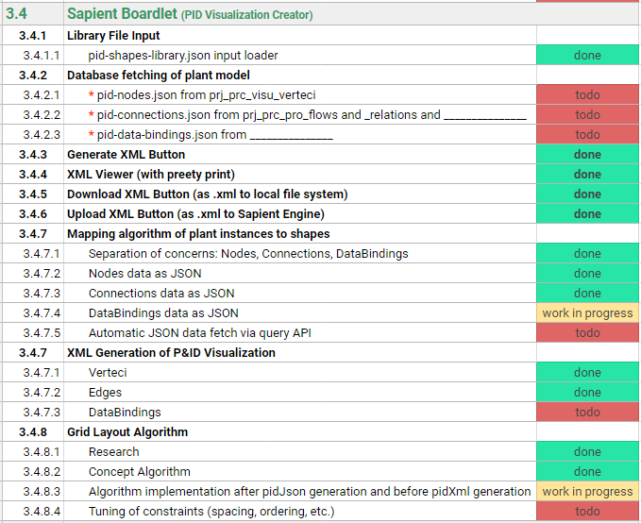
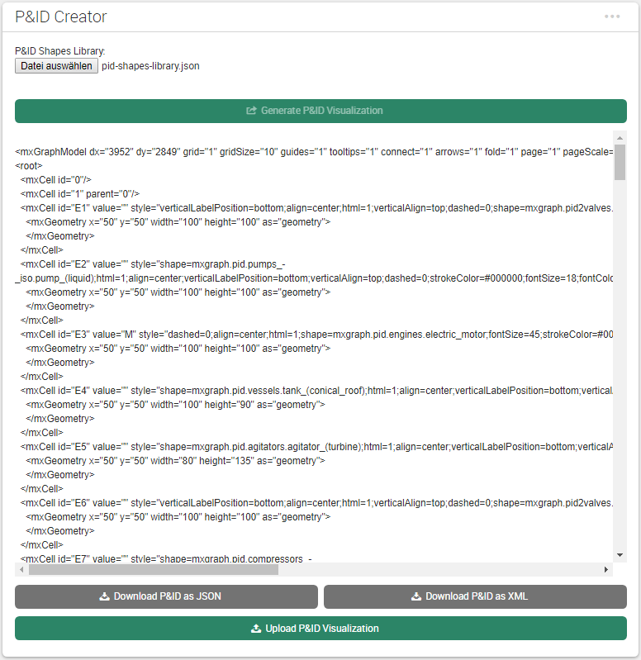
Sapient Boardlet Weekly Sprint 10
1
1
2
In client- background
3
2
3
4
5
In client- background
4
4
5

Slide 9
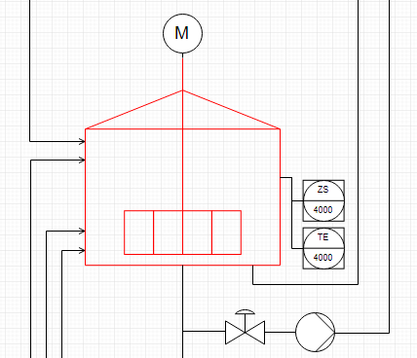
3.4.8 – Vertex Layout Algorithm Concept
Instance Hierarchy Traversal
Instance Hierarchy in model via parent attribute.
Once cModule layer reached, work with place all inside parent.
When done, move to parent’s next children.
Repeat.
Enterprise : AIDA Cruises
1
Site : AIDA
2
Area : Brewery
3
Brewhouse : Process Cell
4
Unit : U_L2
5
U_M5
1
U_P3
5
U_W3
1
EModule : Water_injection
6
Stem_ heating
11
16
…
…
…
…
…
…
…
…
…
…
…
…
…
CModule :
6
7
8
9
10
12
13
14
15
…
…
…
…
…
…
…
Control_valve_440
Pump_P40
Motor
Kettle_sensor_Z
Kettle_sensor_T

Slide 10
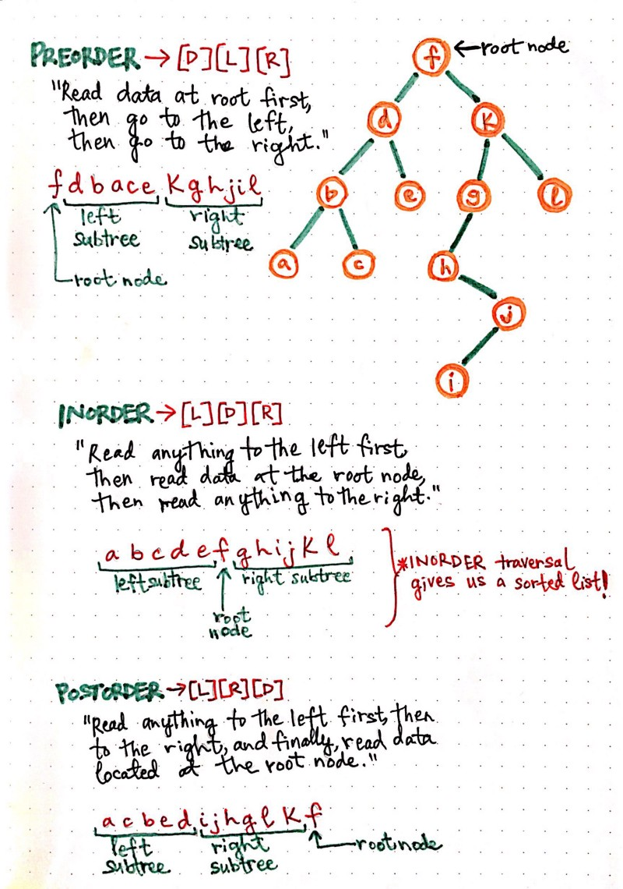
3.4.8 – Vertex Layout Algorithm Concept
Tree (hierarchy) traversal methods
Preorder [D][L][R]
Inorder [L][D][R]
Postorder [L][R][D]
Vertex placement, then next vertex placement, then next vertex placement, … , finally group placment
https://medium.com/basecs/demystifying-depth-first-search-a7c14cccf056

Slide 11


3.4.8 – Vertex Layout Algorithm Concept
Vertex Placement
Depth-first traversal of instance hierarchy (IH) via parent attribute until cModule.
Vertex placement inside group: relative positioning with constraints
Rules for example: if (valve to instrument) : instrument above valve
Implement units and cModules as groups (containers) with mxGraph API.
Count units to construct general grid layout.
Geometry between neighbouring children
$$x=w_{p}+s$$
y$=h_{p}−$ $h_{n}$
wn/2
wp/2
(x, y)
hn/2
hp/2
(0, 0)
spacing
Hgmax (currently)
$$r$$
Wgmax (currently)
Relative Positioning
vertex placement group placement group placement … (recursively)
Parent vertex
(0, 0)
(-0.5,0.5)
(0.5, 0.5)
(1, 1)

Slide 12
Issues and challenges Weekly Sprint 10
Default sizes not to scale → Size modifications to be made (defaults left for now)
Layout algorithm: clarity and structure over efficiency → Optimization not that important
Instance hierarchy (parent-child relationships defined in l_nodes) will serve for inclusion graphing algorithm to group
shapeName defines line type, but line type is implemented as a stereotype, or under which table?
Use node_level (0-4: site, area, cell, unit, emodule) for groups or set shapeName also for these instances in l_nodes (for example: shapeName = site_group)
Instrumet is CModule. But is its node_level the same as his parent’s (for example tank), or one less?

Slide 13
Next Sprint Weekly Sprint 10

